Slide 1
HCI Evaluation Part Two
Dr Jon Bird
jon.bird@bristol.ac.uk
Thanks to Stuart Gray, Pete Bennett, Simon Lock, Thomas Bale, Harry Field who developed some of these slides
Images are royalty free from www.pexels.com

Slide 2

Today’s Lecture
Questionnaires
NASA Task Load Index (NASA TLX)
System Usability Scale (SUS)
Statistical tests to determine if the perceived workload or system usabiity score has changed significantly

Slide 3

Questionnaires - defined
Questionnaires involve asking people to answer questions either on paper or digitally e.g. on a webpage or app
They can be used at scale with low resource requirements
They generate a collection of demographic data and user opinions
They can be used to evaluate designs and for understanding user requirements

Slide 4
Questionnaires - tips
Ensure that you are asking a feasible number of questions (question fatigue is a thing)
Watch out for leading questions e.g. “Why did you have difficulty with the navigation?”
It is difficult to produce your own questionnaires
It is best to use existing questionnaires that have been validated i.e. they measure what they claim to be measuring
I’ll now introduce you to two widely used questionnaires

Slide 5
NASA TLX
The NASA Task Load Index (TLX) is a questionnaire that estimates a user’s perceived workload when using a system.
Workload is a complex construct but essentially means the amount of effort people have to exert, both mentally and physically, to use a system.
It was developed by Sandra Hart of NASA’s human performance group and Lowell Staveland of San Jose University.
The focus is on measuring the “immediate often unverbalized impressions that occur spontaneously” (Hart and Staveland, 1988). These are difficult or impossible to observe objectively.

Slide 6
NASA TLX 2
Originally the NASA TLX questionnaire was developed for use in aviation but it’s since been used in many different domains, including air traffic control, robotics, the automative industry, healthcare, website design and other technology fields.
Since it was introduced in 1988, it has had over 8000 citations.
It is viewed as the gold standard for measuring subjective workload.

Slide 7
NASA TLX 3
Originally it was developed as a paper and pencil questionnaire but there are also free apps for iOS and Android
The official website is here: https://humansystems.arc.nasa.gov/groups/TLX/index.php

Slide 8
NASA TLX 4
The NASA TLX uses a multi-dimensional rating procedure that derives an overall workload score based on a weighted average of ratings on six subscales: - Mental Demand - Physical Demand - Temporal Demand - Performance - Effort - Frustration

Slide 9
NASA TLX 5
Mental demand – how much mental and perceptual activity was required?
Physical demand – how much physical activity was required?
Temporal demand – how much time pressure did the user feel due to the rate at which tasks occurred?
Frustration – how insecure, discouraged or irritated did the user feel in the task?
Effort – how hard did the user have to work (mentally and physically) to accomplish their level of performance?
Performance – how successfully did the user think they accomplished the task?

Slide 10
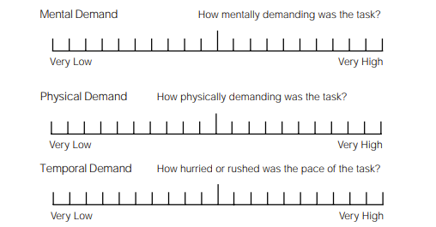
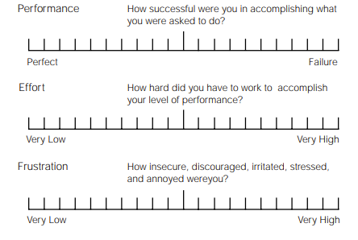
NASA TLX 6

Slide 11
NASA TLX Scoring 1
Users answer the NASA TLX after they have completed a task. This is necessary as asking them to complete it during task is typically not possible. However, it may mean that users forget details of the perceived workload.
The questionnaire is scored in a two step process:
Identifying the relative importance of the 6 dimensions on a user’s perceived workload
Rating each of the 6 dimensions on a scale

Slide 12
NASA TLX Relative weighting of dimensions 1
A user reflects on the task they’ve been asked to perform and is shown each paired combination of the six dimensions to decide which is more related to their personal definition of workload as related to the task.
This means a user considers 15 paired comparisons. For example, they need to decide whether Performance or Frustration “represents the more important contributor to the workload for the specific task you recently performed.”
Each time a dimension is selected as more important it receives a score of 1. The total score is the weight of the dimension and ranges from 0 to 5.
The sum of the weights should be 15.

Slide 13
NASA TLX Relative weighting of dimensions 2
The relative weighting of the six dimensions is often not measured or used.
Not measuring the relative weighting makes the NASA TLX simpler to administer.
Several studies have compared raw TLX scores to weighted TLX scores and have found mixed results (some showing better sensitivity when removing weights, others showing no difference, and others showing less sensitivity).
When the dimensions are not rated the method is called the ‘raw TLX score’

Slide 14
NASA TLX Rating the dimensions 1
Users mark their score on each of the six dimensions.
Each dimension consists of a line with 21 equally spaced tick marks, which divide the line from 0 to 100 in increments of 5. If a user marks between two ticks then the value of the right tick is used.
The score on a dimension is calculated as the tick number (1, 21) – 1 multiplied by 5.

Slide 15
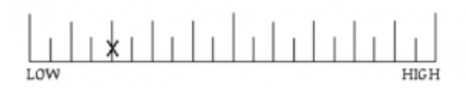
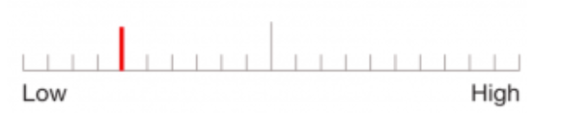
NASA TLX Rating the dimensions 2
For example, the images show the rating on a paper questionnaire (top) and on a mobile app (bottom)
The fifth tick mark is selected, so the rating score is: (5 – 1) * 5 = 20

Slide 16
NASA TLX What do the scores tell us?
If the weights are used then the individual ratings on each of the dimensions are multiplied by their respective weights, summed and divided by 15, resulting in an aggregate perceived workload score for a task ranging from 0 – 100.
If the weights are not used then the individual ratings on each of the dimensions can be summed and divided by 6, resulting in an aggregate perceived workload score ranging from 0 – 100.
The individual ratings on the 6 dimensions also give some insight in to where the workload is coming from. This can be helpful for developers hoping to improve their design.

Slide 17
NASA TLX Validity
Hart and Staveland validated that the sub-scales measure different sources of workload.
Subsequent independent studies have also found that the NASA TLX is a valid measure of subjective workload (Rubio et al, 2004; Xiao et al, 2005).

Slide 18
System Usability Survey (SUS)
The System Usability Scale (SUS) provides a “quick and dirty”, reliable tool for measuring usability.
It was created by John Brooke in 1986.
It consists of a 10 item questionnaire with five response options for each item ranging from Strongly agree to Strongly disagree.
It enables the evaluation of a wide variety of products and services, including hardware, software, mobile devices, websites and applications.

Slide 19
System Usability Survey (SUS) - benefits
SUS has become an industry standard, with references in over 1300 articles and publications.
The noted benefits of using SUS include:
It is a very easy scale to administer to participants
It can be used on small sample sizes with reliable results
The SUS has been validated and shown to effectively differentiate between usable and unusable systems

Slide 20
System Usability Survey (SUS) - scale
When an SUS is used, participants are asked to score the 10 items with one of five responses that range from Strongly Agree to Strongly disagree i.e. using a five point Likert scale

Slide 21
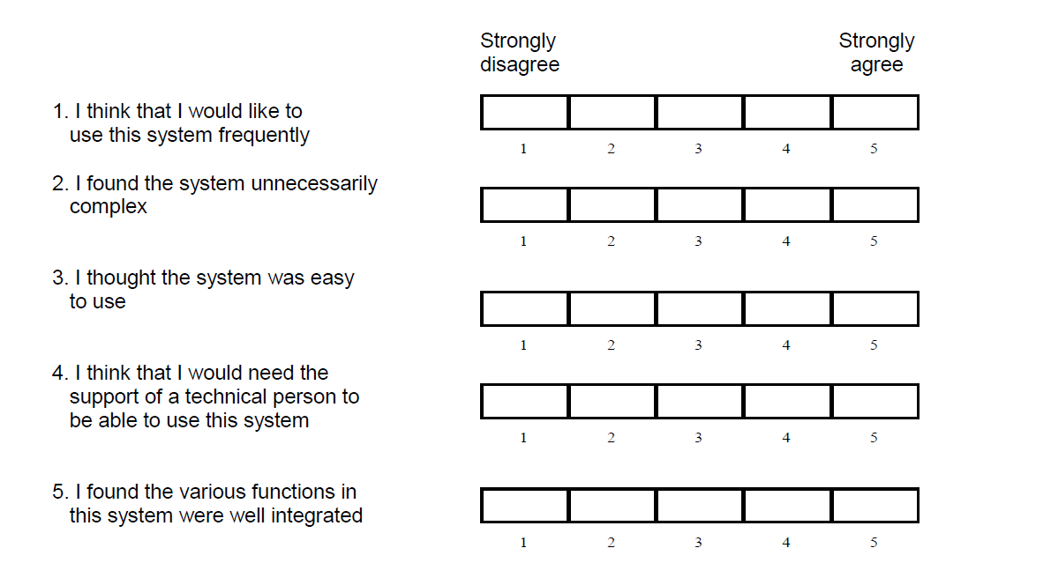
System Usability Survey (SUS) – scale 2

Slide 22
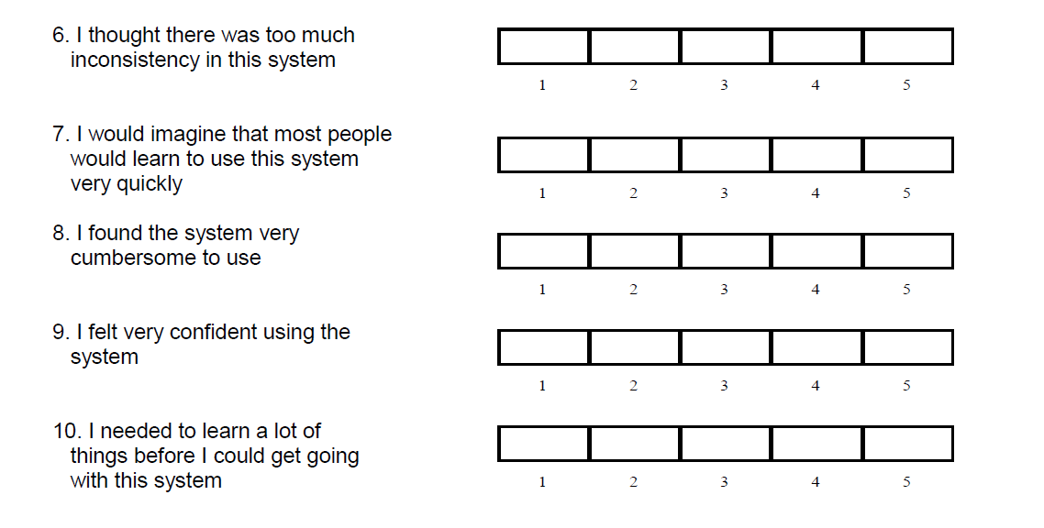
System Usability Survey (SUS) – scale 3

Slide 23
System Usability Survey (SUS) – scoring 1
The SUS is given to users when they have completed using the system which is being evaluated
They score each of the 10 items by marking one of the five boxes
The SUS yields a single number representing a composite measure of the overall usability of the system being studied. Note that scores for individual items are not meaningful on their own.

Slide 24
System Usability Survey (SUS) – scoring 2
To calculate the SUS score, first sum the score contributions from each item. Each item's score contribution will range from 0 to 4.
For items 1,3,5,7,and 9 (the odd numbered items) the score contribution is the scale position minus 1. For items 2,4,6,8 and 10 (the even numbered items) the contribution is 5 minus the scale position.
Multiply the sum of the scores by 2.5 to obtain the overall score.
SUS scores have a range of 0 to 100.
Based on research, a SUS score above 68 would be considered above average and anything below 68 is below average.

Slide 25
Statistical testing
You might get a user to rate the SUS of two different designs and want to know if one design is significantly better than the other.
Similarly, you might want to know if two levels of difficulty in your game are significantly different so you get a user to rate the workload of both levels.
To determine whether the differences in scores are significantly different we can use a statistical test

Slide 26
Statistical testing 2
There are many statistical tests but I am going to show you two that will be useful for your project.
The first is the Wilcoxon Signed Rank Test and it is ideal for analysing data from Likert and other scales e.g. the NASA TLX and SUS.
It is used when one user carries out two evaluations e.g. rates the workload of your game at two different difficulty levels.
It is a good test when you have small numbers of users – the minimum is 5; however, it’s better at identifying significant differences when you have larger numbers of users.

Slide 27
Statistical testing 3
Make a table where each row represents a user’s scores and each column a separate evaluation score.
I’ve shown the results of three users evaluating the workload of a game at two difficulty levels using the NASA TLX.
You need a minimum of 5 and ideally more
User ID | Workload level 1 | Workload level 2
U1 | 25 | 67
U2 | 32 | 56
U3 | 18 | 43

Slide 28
Statistical testing 4
Enter the data into the online calculator: https://www.statology.org/wilcoxon-signed-rank-test-calculator/
Look up the calculated W test statistic in the table of critical values
To do this you need to know N, which is the number of users, and the significance level, which we will set at 0.05
This means that if a significant difference is found then it is 95% certain that this is a real difference rather than due to randomness

Slide 29
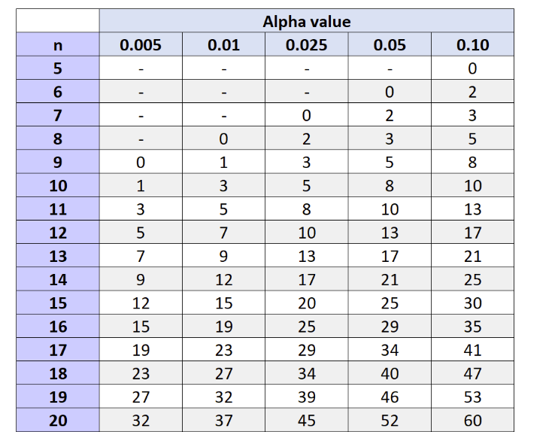
Statistical testing 5
We use an alpha value aka significance level of 0.05
We find the row that corresponds to our number of users aka n.
If we have 10 users then the W test statistic generated by the online calculator needs to be less than 8 otherwise there is no significant difference.

Slide 30
Statistical testing 6
If we are comparing two sets of values generated by two different groups e.g. experienced gamers and novice gamers then we use a different test to see if they are significantly different
This is known as the Mann-Whitney U test. There is also an online calculator and you can read about the test here:
https://www.statology.org/mann-whitney-u-test/

Slide 31

Reading
Read the original paper on the NASA TLX:
Hart, S. G., & Staveland, L. E. (1988). Development of NASA-TLX (Task Load Index): Results of empirical and theoretical research. In Advances in psychology (Vol. 52, pp. 139-183). North-Holland.
Read the original SUS paper
Read more about the Wilcoxon signed rank test

Slide 32


Before the workshop next week
Please review the lecture materials on the NASA TLX and SUS
Your workshop activities will involve evaluating your games using these two techniques

